Slide 1
Advanced Spreadsheet
CMPS 1024
Inaldi Gomez

Slide 2
Objective
Finish on VLOOKUP ()
HLOOKUP ()
PMT ()
Assignment
Lesson

Slide 3
VLOOKUP vs HLOOKUP
Both can take 4 arguments
Lookup_value
Table_array
Col_index_num / row_index_num
[range_lookup] (true/false), (approximate match, exact Match)
VLOOKUP looks vertically for data while HLOOKUP looks horizontally for data
HLOOKUP does a case insensitive lookup which means that “SITE” = “site” when searching for a match.
In HLOOKUP the function “lookup_value” should always be in the top most row while in VLOOKUP it can be anywhere in the first column
Range_lookup value is optional however in the VLOOKUP the default is False while in the HLOOKUP the default is True
More on Logical Functions
HLOOKUP Function

Slide 4
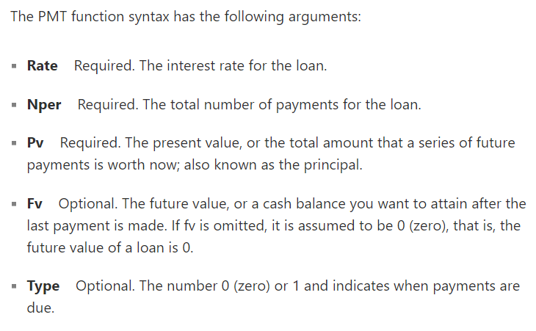
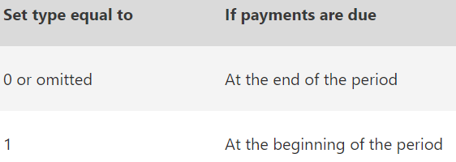
PMT () Financial Function
Calculates the payment for a loan based on constant payments and a constant interest rate
Will this work for compounded interest? Or Reduced balance interest?
PMT (rate, nper, pv. [fv], [type])
5 arguments – 3 required and 2 optional

Slide 5
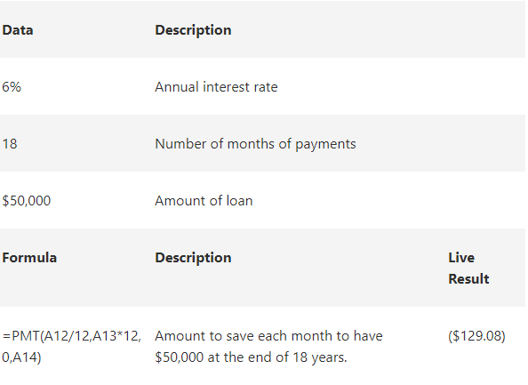
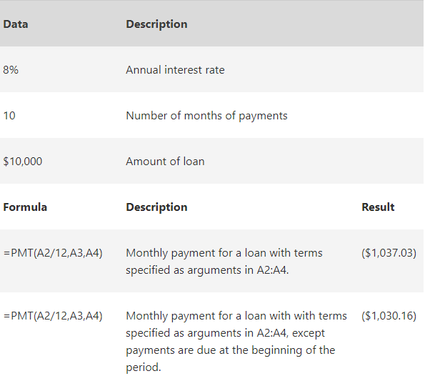
PMT () Cont…
PMT includes principal and interest but no Tax, reserve Payments, or fees that can be associated with loans
Be consistent with units used for rate and nper eg.
If you make monthly payments on a four-year loan at an annual interest rate of 12 percent, then you wold use 12%/12 for the rate and 4*12 for nper.
To calculate the total amount paid over the duration of the loan, multiply the returned PMT Value by the nper

Slide 6
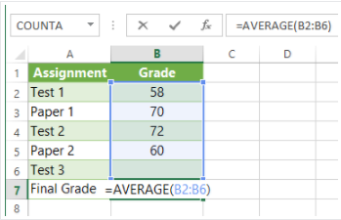
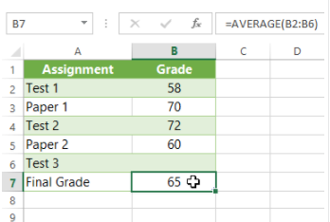
What-If Analysis
This function helps to answer questions with your data even if the data is incomplete.
Need to use the Goal Seek tool
Goal Seek works in reverse when compared to the other formulas and functions. It starts with a desired result and calculates the input values that will achieve the desired result.
Select the Cell that you want to change it’s value.
When using Goal Seek, it is necessary to select a cell that already contains a formula or a function.
B7 contains a function call

Slide 7
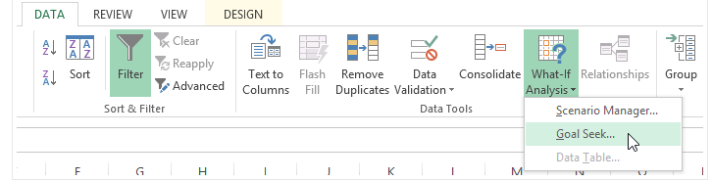
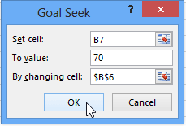
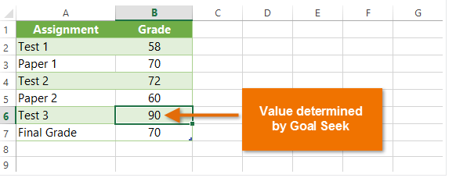
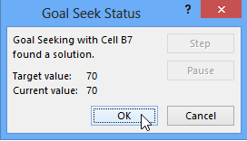
What-If Continued
From the Dialog Box enter the Set Cell: the cell that will contain the desired result and also has
A function/Formula. Click Ok when finished.
Go to Data Tab and select What-If Analysis command, from the drop list select Goal Seek
The dialog box will tell you if Goal Seek was able to find a solution and you proceed to select OK

Slide 8
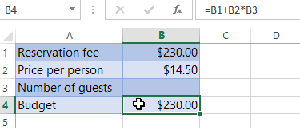
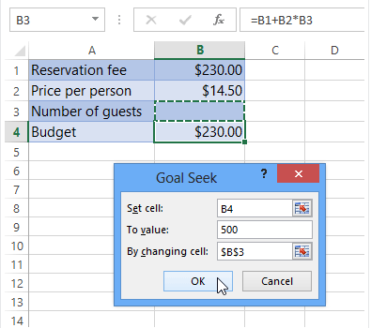
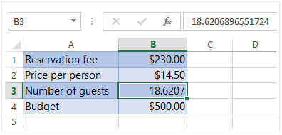
What-If Continued
You are planning a party and you want to invite as many people as you can with the budget you have. ($500)
So lets assume your budget is the following Reservation Fee cost + Price per person(#persons) will equate to final Budget
Go to to the ribbon Tab
Data>What-If Analysis>Goal Seek
Fill in the dialog box

Slide 9
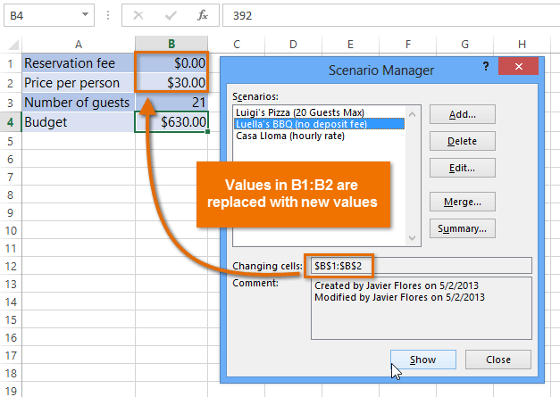
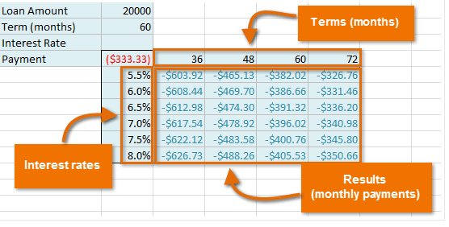
Other What-IF Analysis Feature
Data tables(multiple results at once)- allow you to take one or two variables in a formula and replace them with as many different values as you want, then view the results in a table.
Multiple Scenarios – substitute values of multiple cells (up to 32) at the same time.
Use Scenario Manager

Slide 10
Spreadsheet Tasks
Friday Forum Due!
Tuesday next week (July 11, 2017) Assignment 3 Due
Tomorrow Test 2 starts at 5:30 p.m. both Theory and Practical

